Slide 1
Using the data and changing the map
Ben Chapman
North Carolina State University
February 27, 2014

Slide 2
Ethnography and other qualitative methods
The literature has lots of non-conformances and problems
It has little on what you do with qualitative results
How to interpret them, implement changes

Slide 3
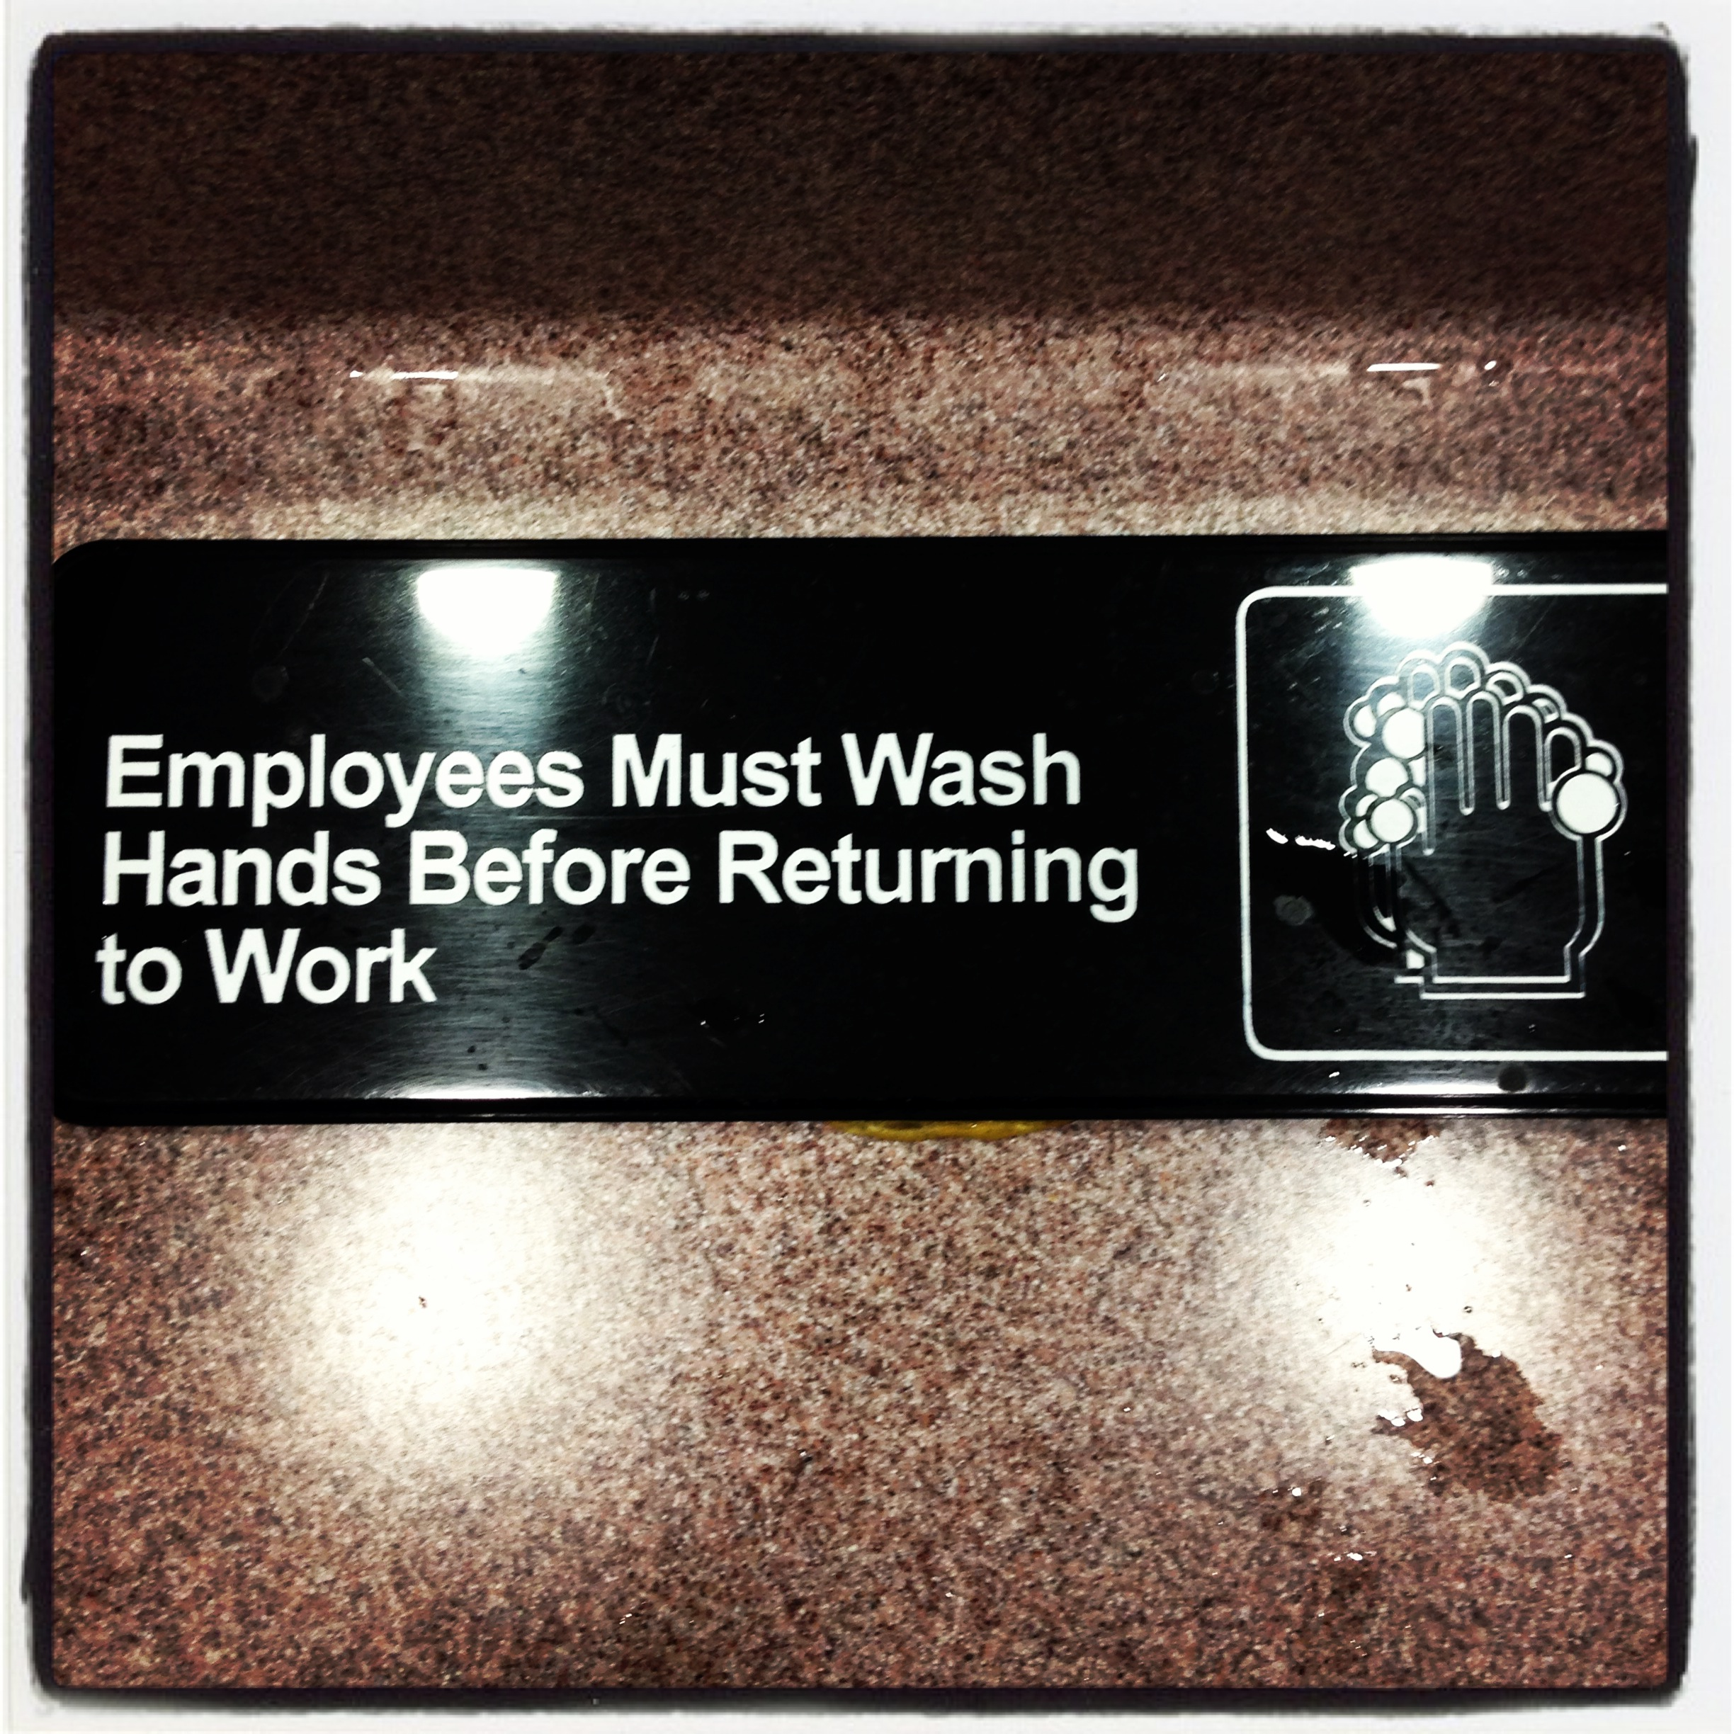
Quantitative data tells you what to prioritize
Qualitative data tells describes what went wrong, how wrong, and why
To change the map, you don’t focus on being more prescriptive
Focus on the story, the why’s the hows and control

Slide 4
Attitude towards
behavior
Subjective norm
Intention
Behavior
Perceived
behavioral control
Theory of planned behavior, Ajzen, 1991

Slide 5
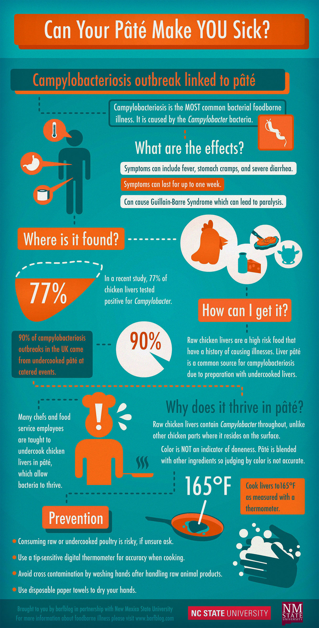
How to make them care?
People actually get sick from this
Illnesses are often largely preventable
You (whomever the message is for) have some control
I’m going to show you how to do it/give you the tools
And explain why the exact thing you are getting wrong matters

Slide 6
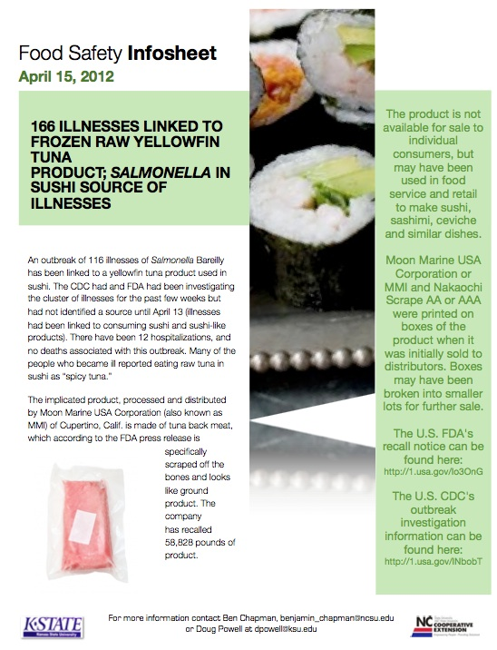
barfblog.com/infosheets

Slide 7
Current system
Field Specialist
Present findings to Corporate
Corporate
Send Stores material
Employees
Create information
Delivered and slow
Low-Road Transfer
of learning
Notes:
Motion activated media at a mindless long-duration task (washing dishes)
Some general, some location specific. Corporate develops material, Manager loads media, maybe Corporate loads it)
Screen plays:
Headline news (reinforce risk → consequences)
Appropriate behavior- written?
Video short with other store employee presents examples and tips (subjective norm, behavioral control, competition)
Being in a video (could) be a reward for conscientious employees. Field Specialists record videos at other audits.

Slide 8
Auditor/verifier to Employee
Field Specialist
Employee
Immediate response
Model proper practice (from a bank of options)
Focus on risk/results
Hands on learning
Change in risk perception
Behavior can control outcomes
Near Transfer
of learning
Notes:
Demonstrate correct behavior
Explain risk, back up with real world example
Have employee execute behavior
(-) only one-time intervention

Slide 9
Manager to Employee
Field Specialist
Issue-based training resources (You’ve got these problems)
Manager
Incorporate training into daily checks.
Employee
Context based triggers (if you see this, do this)
Triggers = opportunity
Efficiency and safety focused (why its important)
Hands on training
In context
Risk
Near Transfer
of learning
Notes:
Manager does daily checks. Co-packages with their checklist is lessons.
Lessons are tied to triggers in the form (you checked NO, go to lesson 3 with these people)
Demonstrate correct behavior
Explain risk, back up with real world example: Negative from news, Positive maybe from other high performing stores?
Have employee execute behavior
Allows for reinforcement
Develop manger expectations for employees(subjective norm.)

Slide 10
Generate specific data
Use it to characterize why things go wrong (because you already have the priority info)
Create materials that are focused on control and tell the why’s
Look at multiple delivery mechanisms

Slide 11
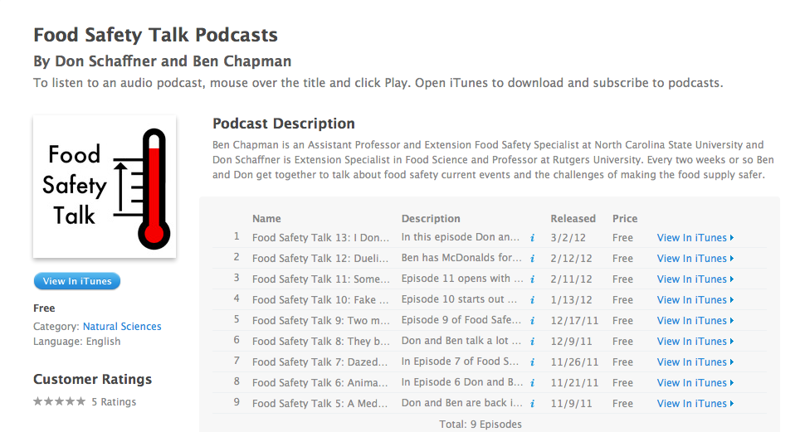
www.foodsafetytalk.com

Slide 12
Dr. Ben Chapman
benjamin_chapman@ncsu.edu
Follow me on twitter @benjaminchapman
919 809 3205
www.foodsafetytalk.com
barfblog.com

